Slide 1
The Evolution of Distributed Computing and Integration
Oxford University
Software Engineering Programme
Dec 2013

Slide 2
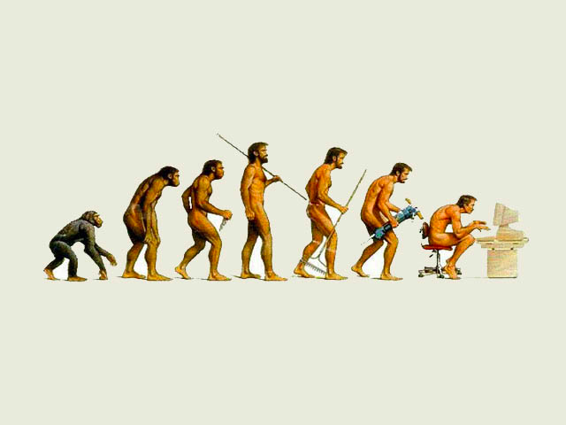

Slide 3
Distributed Computing

Slide 4
Why is Distributed Computing important?
Scale
Evolution
Integration
Cross-boundary

Slide 5
DCE
Standardized remote procedure call model proposed in the 90s by the Open Software Foundation (OSF)
Didn’t succeed widely, except as part of Microsoft’s DCOM

Slide 6
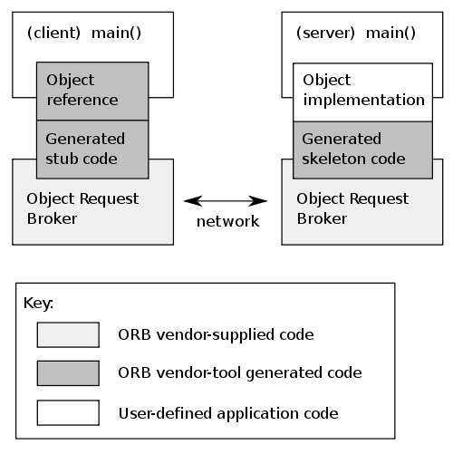
CORBA Common Object Request Broker Architecture
An attempt to move DCE like distributed computing into the OO world
Object Management Group (OMG)
Still in some use today
Stagnated/Deprecated

Slide 7
SOAP
XML approach to replace CORBA/DCE, etc
Theoretically built to be transport independent and message oriented
97% of the time used over HTTP in RPC model
We will cover in much more detail later

Slide 8
REST
Representational State Transfer
A model that influenced and was based on HTTP 1.1
Web approach to distributed computing and integration
We will cover in much more detail later

Slide 9
Next generation RPC
Java RMI (Remote Method Invocation)
Google Protocol Buffers
Apache Thrift
Apache Avro
Kryo etc
Twitter’s Finagle

Slide 10

Integration

Slide 11
Integration
It is unhelpful to consider Distributed Computing and SOA without considering Integration
Integration is the problem of creating applications that incorporate existing as well as new logic
Almost no system is standalone and does not need to evolve!
Even embedded systems are now moving to incorporate Internet and Messaging

Slide 12
Integration points
Data
Integration in the database layer
Application
Inter-application integration
Web tier
Portal based integration
On-the-glass
Cut and paste

Slide 13
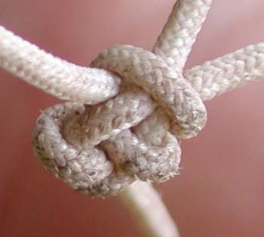
Tightly coupled
Tightly coupled systems have significant problems:
Errors, delays and downtime spread through the system
The resilience of the whole system is based on the weakest part
Cost of upgrading or migrating spreads
Hard to evaluate the useful parts from the dead weight

Slide 14
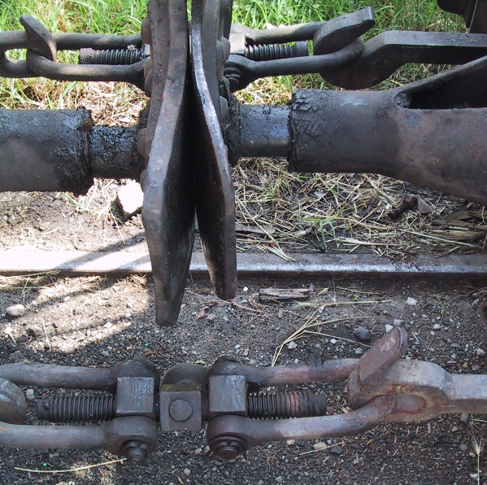
Loose coupling

Slide 15
“6 Degrees of Separation”
Location
Access
Programming Language
Stack/Vendor
Time
Scalability
Notes:
X.901 defines: access, location, migration, replication, concurrency, scalability, performance, failure

Slide 16
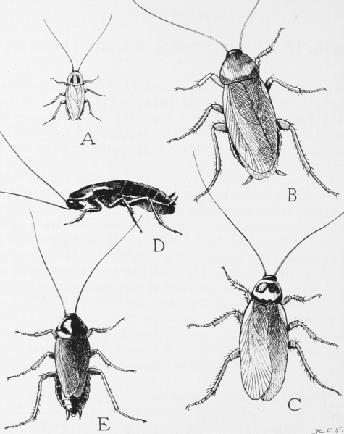
Batch file transfer - the cockroach of integration

Slide 17
File transfer lives on
Existing System
Existing System
XML/JMS
legacy
flat file
WSO2 ESB
Split/Iterate
DBLookup/Filter
Transform to MQ
Send
Database
WSO2 ESB
Poll
Record->XML
XML->XML
Send
NEW YORK
LONDON

Slide 18
EAI
Hub

Slide 19
EAI hub
Many integration models still uses the “hub model” today (even with an ESB)
Most vendors renamed their hub to ESB
Why?
Well understood pattern
Easy to manage
Why not?
Too many meetings with the “EAI Hub Team”
Too centrally managed (MQSI experiences)

Slide 20
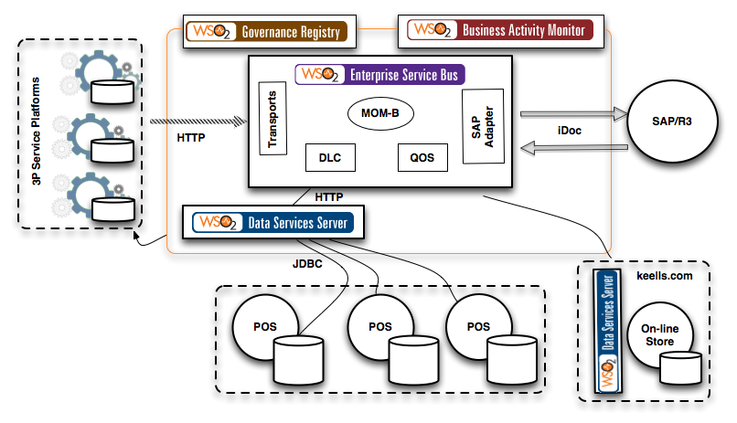
Hub approach with an ESB

Slide 21
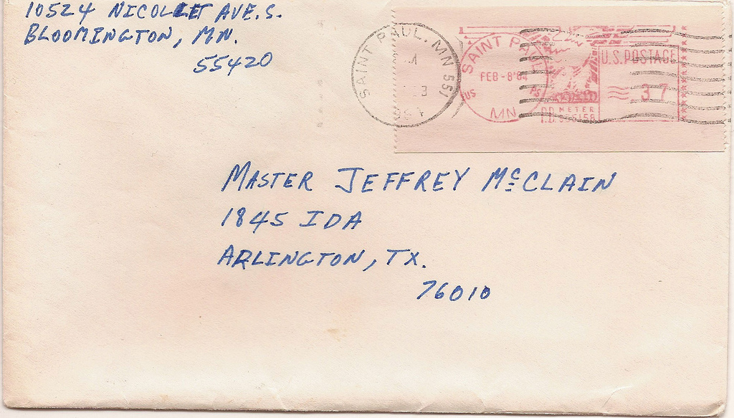
“Message Oriented Middleware”
http://www.flickr.com/photos/robeast/

Slide 22
MOM model
Decouple message producers from consumers
Decoupled in addressing and in time
Not inherently decoupled in message format
Though in many cases that too
One-way asynchronous messages
But request-reply possible using “Reply Queues”
Usually used with reliable delivery

Slide 23
Queued Transaction Processing
System A
Queue
Transaction 1:
Add entry to DB1
Enqueue Message
Transaction 2:
Add entry to DB2
Dequeue Message
DB1
DB2
System
B

Slide 24
AMQP

Slide 25
AMQP
Emerged out of JP Morgan
Wanted an open source/open standard alternative to proprietary (e.g. MQSeries)
Standardized at OASIS
Multiple Open Source implementations
RabbitMQ, Apache Qpid, WSO2 Message Broker, Apache Apollo, Apache ActiveMQ, etc
Used widely e.g. in OpenStack

Slide 26
MQTT
Very lightweight messaging pub/sub system
Built for SCADA, M2M, IoT
Being standardised at OASIS MQTT TC
Close to being done
No wire changes from 3.1
Big effort in the Eclipse Paho / M2M project

Slide 27
Event Driven Architecture
Event Consumer
Event Producer
Event
Event Consumer

Slide 28
“Event Driven Architecture”
Actually how Apache (and WSO2) work(s)
Mailing lists = topics
Can be layered with reliable delivery
Used a lot in high-volume logging, trading environments, fraud detection, etc
Requires a very different mindset

Slide 29
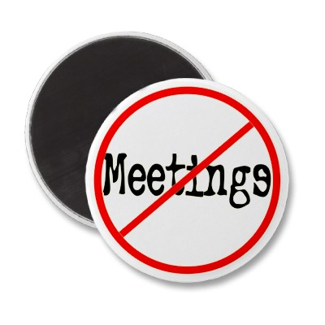
EDA

Slide 30
Feedback loops
Event Broker
Black
Box
system
Adapter
Adapter
Black
Box
system
http://pzf.fremantle.org/2008/09/interesting-problem-in-event-driven.html

Slide 31
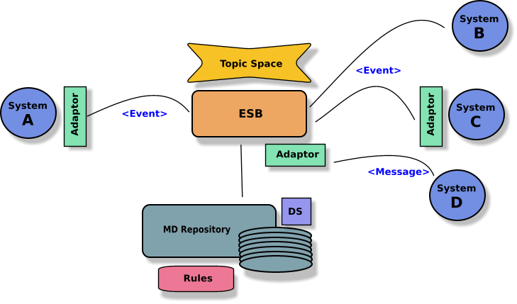
Solution

Slide 32
Why did SOA evolve?
Directly came out of XML
Understanding the schema and structure of messages
Especially within the “fabric” not just at the endpoints
What’s different?
Metadata
Policies
Security

Slide 33

Service
http://www.flickr.com/photos/yjv/

Slide 34
SOA failures
One consumer per service

Slide 35
SOA failures
“Just buy an ESB from me”

Slide 36
SOA failures
Vendor Driven Architecture

Slide 37



“soa” successes

Slide 38
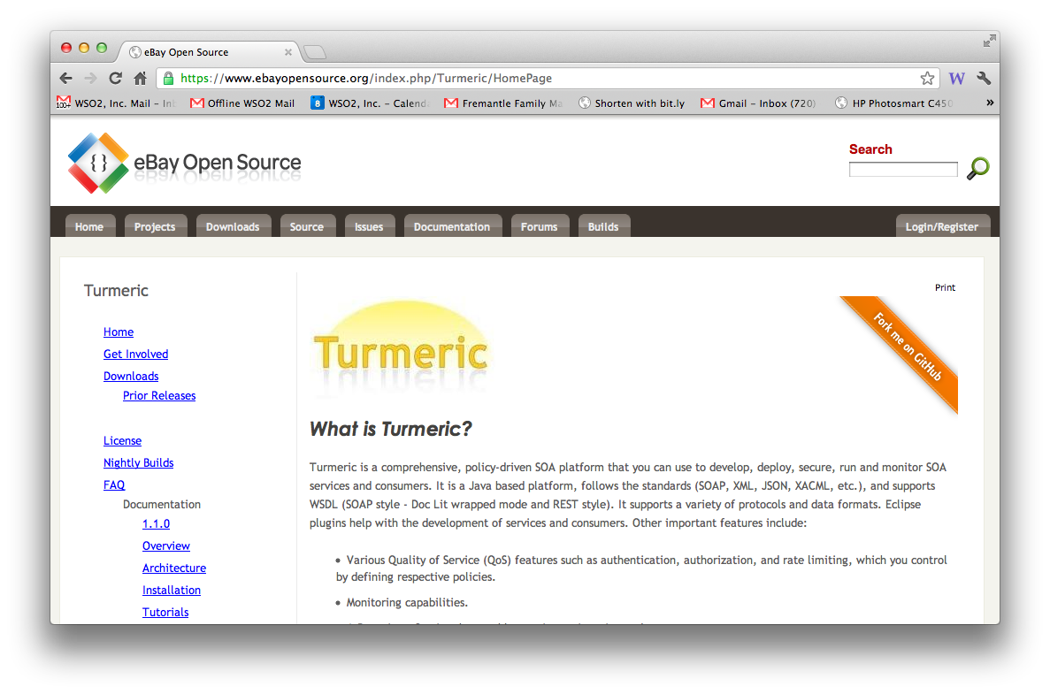

Slide 39
Why ESB/SOA model isn’t just EAI
Policy based
XACML, Throttling Policy, etc
eBay’s Internal Service Router
Independent management
Loose coupling of configuration
Hot deploy / re-deploy / continuous delivery
Governance
Lifecycle and Dependency management
Analysis and reporting on the meta-model
Non-blocking asynchronous routing
Distributed architecture

Slide 40
Web Services != SOA
There are SOA’s that don’t use Web Services
We will see some in the case studies…
There are systems that use Web Services that are not Service Oriented
e.g. Taking an existing text/TCP model and tunnelling over SOAP

Slide 41
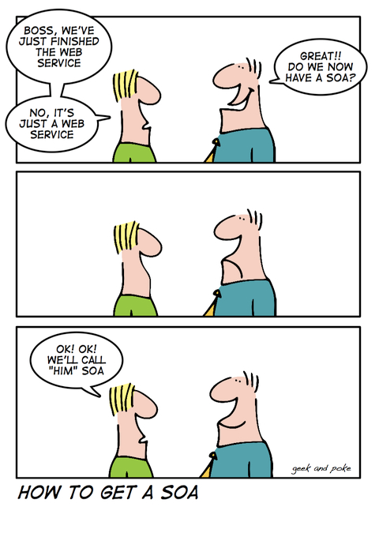

Slide 42
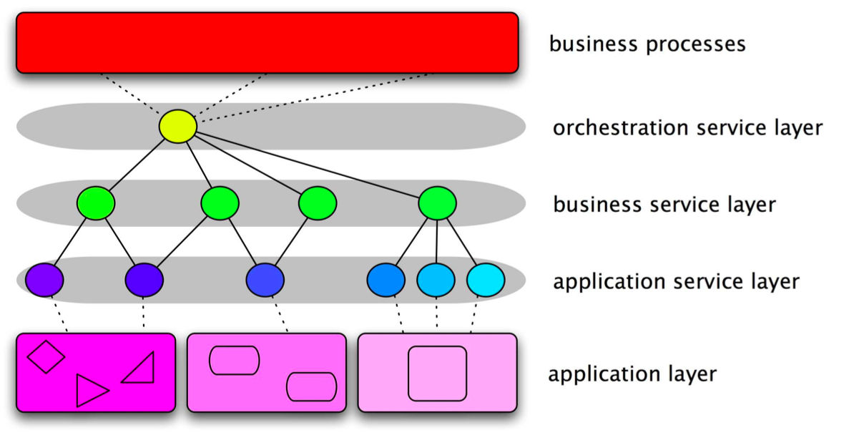
SOA

Slide 43
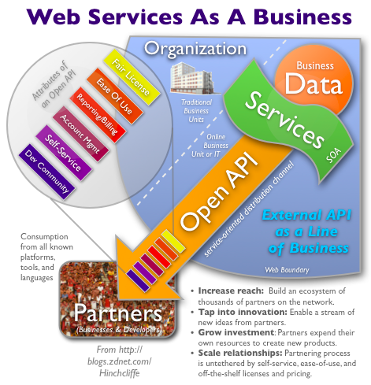
Running your SOA like a Web startup
http://www.zdnet.com/blog/hinchcliffe/running-your-soa-like-a-web-startup/525

Slide 44
API
An API is a business capability delivered over the Internet to internal or external consumers
Network accessible function
Available using standard web protocols
With well-defined interfaces
Designed for access by third-parties

Slide 45
What is different from an API and a Service?
Publishing your API in a Portal
Expecting people to use it without them having to meet with you
Making it easy to consume (JSON? Ready built clients in Github?)
Governance
Caring who uses it
Letting them know when you version it
Meeting an SLA

Slide 46
Key API technologies
json / rest
OAuth / OAuth2 keys
SLA management
API portal / API Store
Catalogue, subscription/purchase
Monetization
Forum, Ratings, Social
Analytics

Slide 47


Slide 48
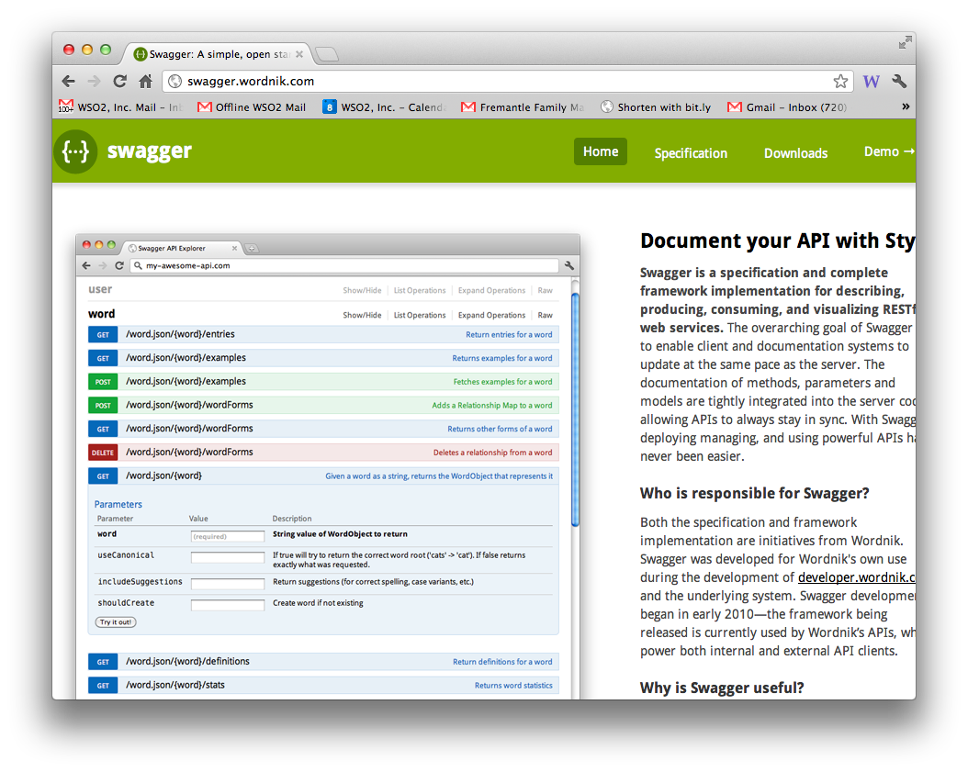
REST description

Slide 49
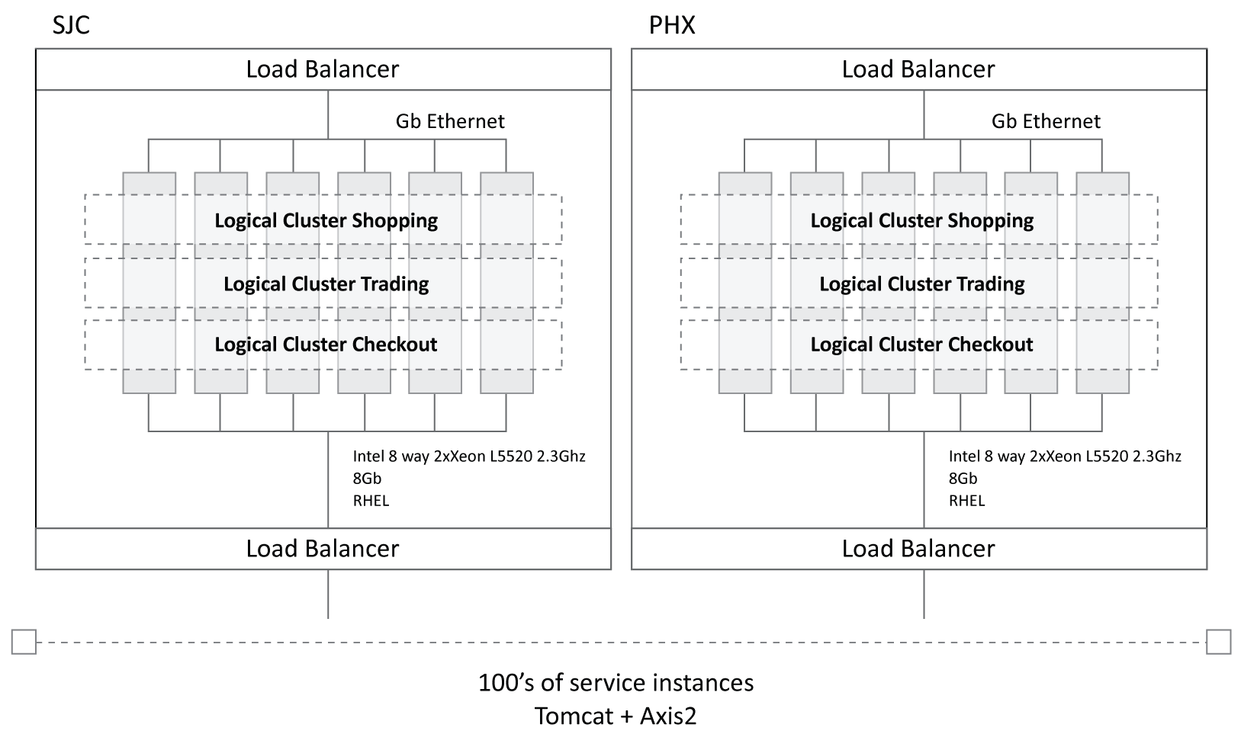
High volume integration @ eBay

Slide 50
Change in focus
Security, tokens, access control/entitlement
Throttling, caching
Latency and CPU usage
Monitoring, BAM and CEP

Slide 51
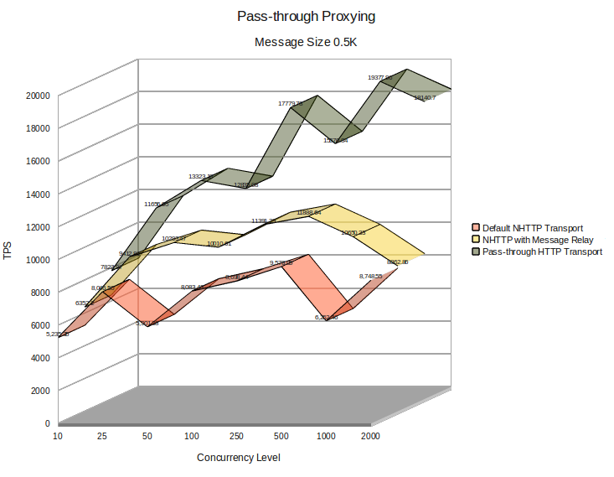
Intel Xeon CPU E5520 @ 2.27GHz, 4 Cores, 8192 KB Cache. 2 CPU system.

Slide 52
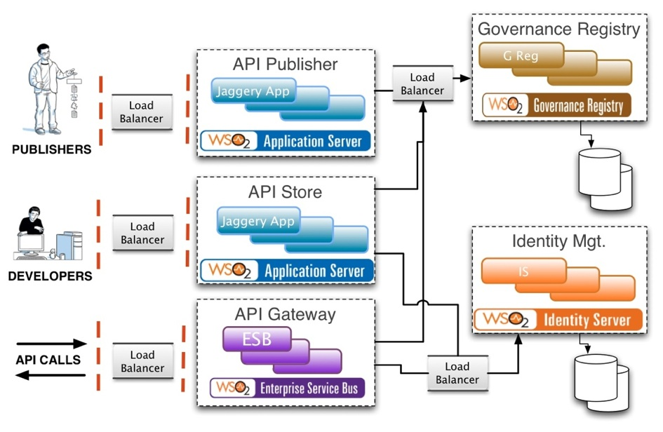
API management
Notes:
API Publisher may actually be purely inside the firewall – if publishing is an internal-only process.
“Load Balancer” can be WSO2 Load Balancer or some other one.
This picture does not show how all activity events are pushed into BAM for analysis, analytics and visualization (using Cassandra and Hadoop).

Slide 53

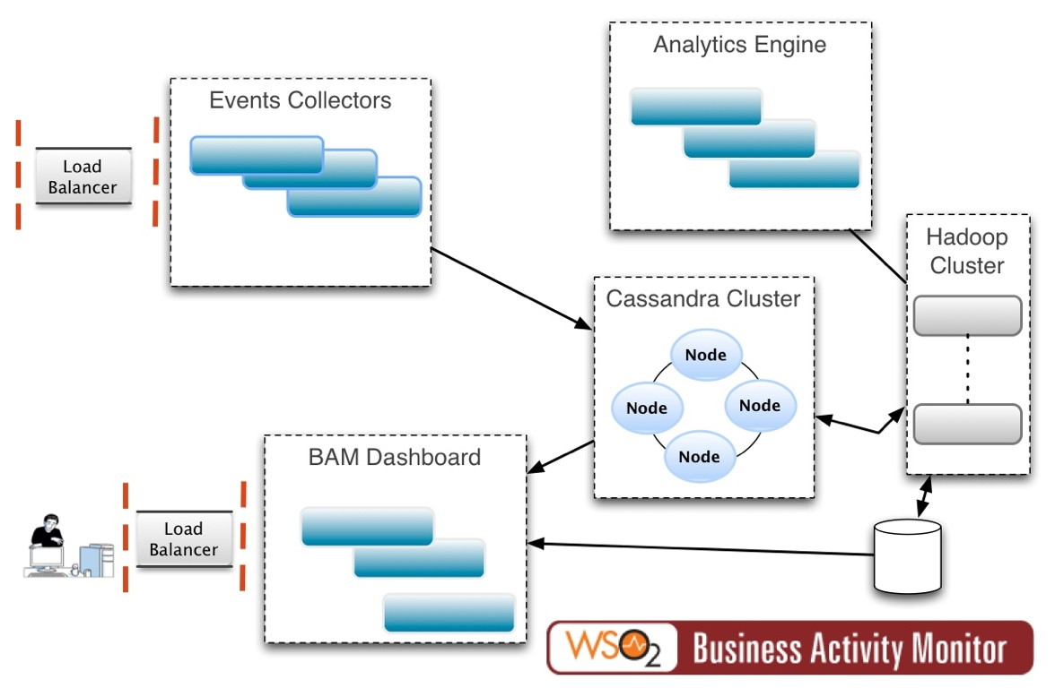
Scalable analytics

Slide 54

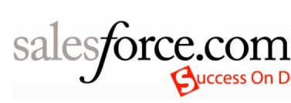

Cloud integration
Cloud Service Gateway
Database
ESB-as-a-Service
SAP

Slide 55
Cloud integration
APIs are the right approach
Use a “cloud gateway” to bridge into internal systems
“Push-me pull-you” pattern
Use an active ESB in the cloud
Analytics
See what is happening

Slide 56
What’s next?
Still a long way from canonical models
Successful systems are using “soa” and “rest” at scale
Architecture is more important than dogma
Governance sounds boring but is key
Applying monetization approaches and “API Economy” models
Analytics and feedback loops

Slide 57
Summary
Integration has evolved in some interesting ways
Async messaging, EDA, APIs, High Volume
Evolution isn’t monotonic
Doing APIs right is about the mindset as much as the technology

Slide 58
?

